Slide 1


Slide 3
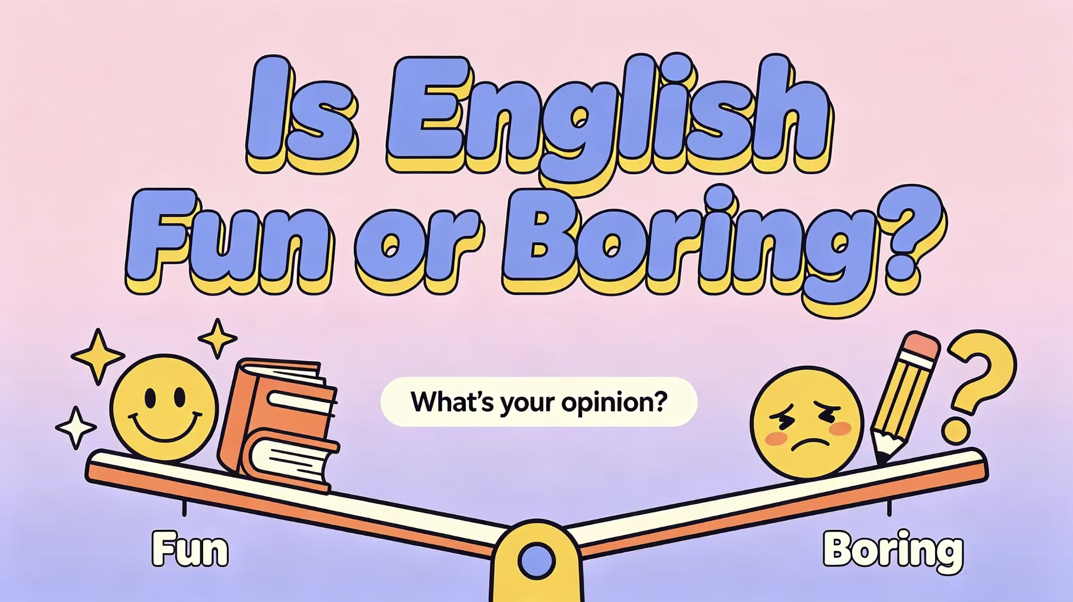
孙玉晗 刘凡语
丁昊 白雪松

Slide 4

English Learning: Difficulties & Strategies
English has become an essential skill in academic and professional life, yet many students struggle with persistent barriers that slow their progress. This survey investigates the key difficulties learners face — from vocabulary retention and speaking anxiety to limited exposure and cultural gaps — and explores practical strategies that make English learning more effective, confident, and sustainable.
Notes:
Good morning/afternoon, teachers and classmates. Today I'd like to share my social survey about the difficulties students face when learning English and the practical strategies we can use.

Slide 5

Contents
1
Background & Purpose
2
Survey Method
3
Main Findings
4
Strategies & Conclusion
Notes:
This presentation has four parts. First, the background and purpose of the survey. Second, how I collected the data. Third, the main difficulties students face. Finally, practical learning strategies and a short conclusion.

Slide 6

Why This Survey?
English is a key skill for study, exams, and future work.
But many students still find it difficult after years of learning.
Information online is everywhere, but which methods really work for us?
Purpose: To find our common difficulties and share practical strategies.
Notes:
English is important for our study and future, but many of us still struggle. There are lots of tips online, but it is hard to tell which ones actually work. So I did this survey to find out what troubles students most and what methods help.

Slide 7

How I Did the Survey
Responses
Method
Participants
Students in our gradedifferent majors
XX valid responses
(to be filled with real data)
Online questionnaire
with multiple-choice questions
Notes:
I used an online questionnaire. I asked students in our grade from different majors. I collected about XX valid responses. The number here should be replaced with your real data.

Slide 8

Main Findings
Notes:
Here are the top three difficulties. The biggest one is memorizing vocabulary — 70 percent of students say they forget words quickly. Next is listening and speaking: they cannot follow fast speech and are afraid to speak. Third is grammar — the rules feel confusing. We will now look at how to deal with each.

Slide 9

However, there are also some people...
However, there is still a large number of people who love English. To them, English is so interesting.

Slide 10

Practical Strategies
1
Vocabulary: Review on a schedule
Learn 20 new words a day, and review them on day 1, 3, and 7. Use them in example sentences.
2
Listening & Speaking: Listen and repeat daily
Listen to short clips 10 minutes a day. Pause and repeat out loud. Talk to yourself in English.
3
Grammar: Learn through examples, not rules
Read short articles and notice how sentences are built. Write 3 sentences each day using the pattern.
The key is small, daily practice—not one long session before a test.
Notes:
Now the strategies. For vocabulary, review on a schedule — day 1, day 3, day 7. For listening and speaking, listen to short clips and repeat out loud every day. For grammar, learn through examples instead of memorizing rules. The most important point: small daily practice works better than cramming before a test.

Slide 11

Conclusion
Most students face the same three difficulties: words, listening, and grammar.
The right methods — review, daily listening, and learning by examples — really help.
Small steps every day matter more than cramming once in a while.
Start today — 20 minutes a day is enough.
Notes:
To conclude: most of us struggle with the same three things — vocabulary, listening, and grammar. With the right methods and daily practice, we can improve. The most important message: start today, even just 20 minutes a day.

Slide 12

Thank You!
Questions & Discussion
Notes:
Thank you for listening. I am happy to take any questions.

